Slide 1
Optimal Sparse Representation & Infinite Gradient
Presenter: Kim Seung Hwan (overnap@khu.ac.kr)

Slide 2
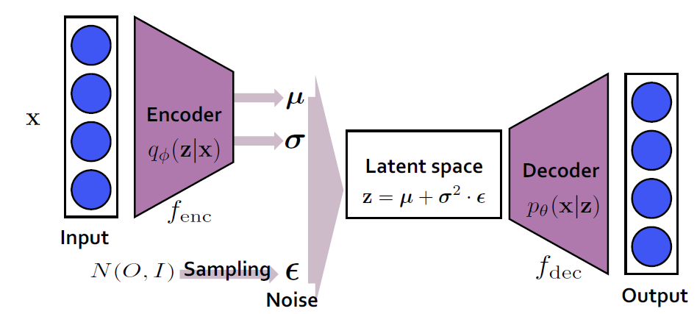

Yet Another VAE PT
Dai, Bin, Li Wenliang, and David Wipf. "On the value of infinite gradients in variational autoencoder models." Advances in Neural Information Processing Systems 34 (2021): 7180-7192.

Slide 3
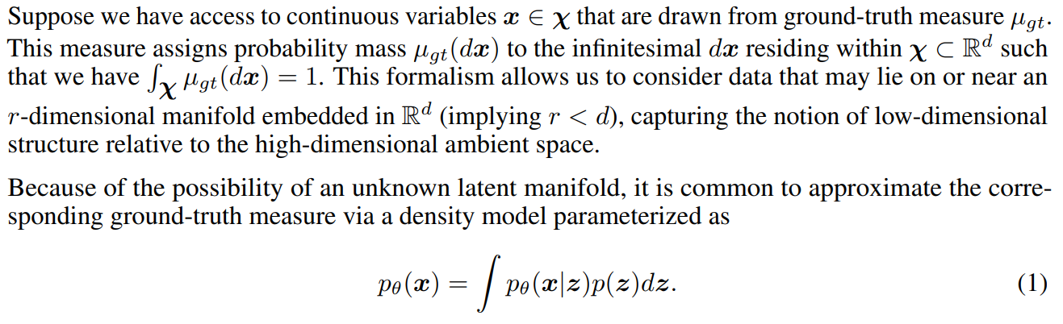

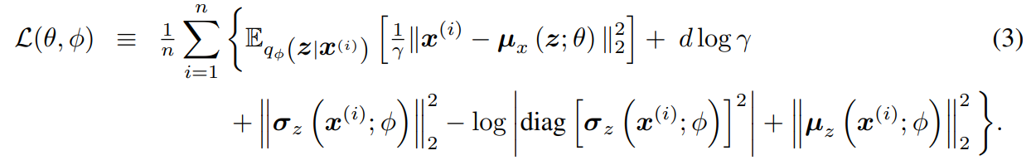

Problem & Definition
Reconstruction loss (Distortion)
Regularization loss (Rate)

Slide 4
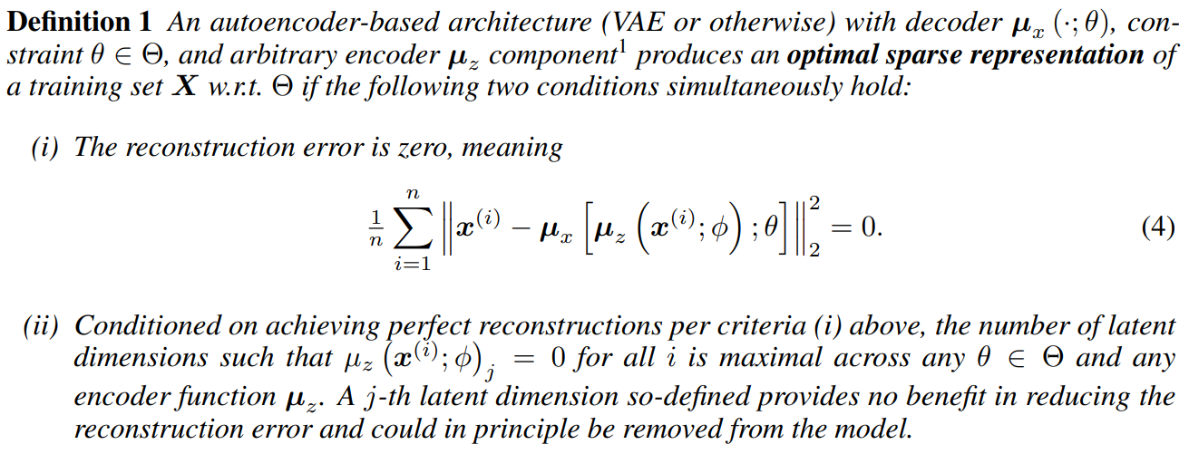
Optimal Sparse Representation
The minimum information that can represent the data manifold
In the words of the authors, “the most parsimonious latent representation”

Slide 5
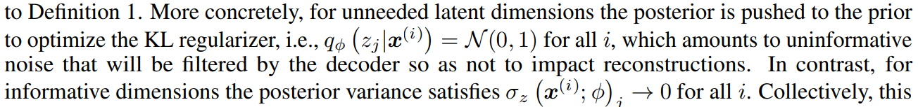
Why Mean?
Is it okay to consider only the mean (of the encoder and decoder?)
Dai, Bin, and David Wipf. "Diagnosing and Enhancing VAE Models." International Conference on Learning Representations. 2018.
Estimated low-noise latent dimensions $≈$ Informative dimension
Power
Result

Slide 6
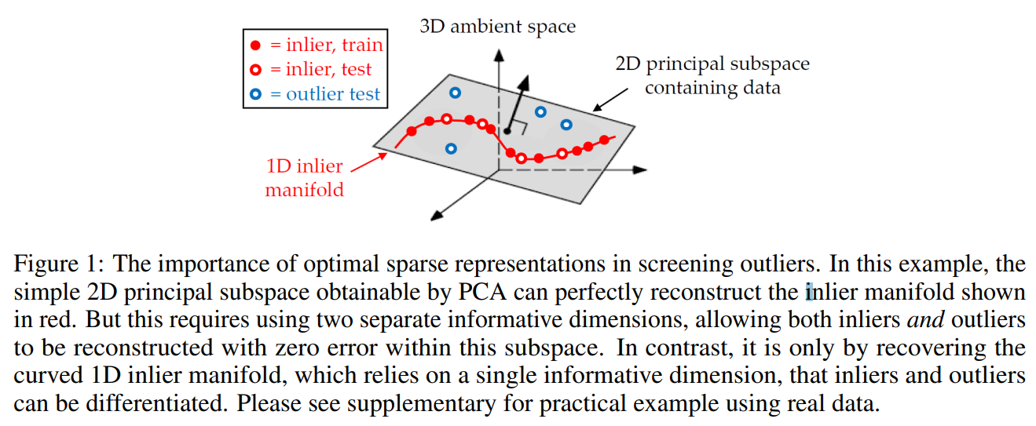
Why Sparse?
Why is sparsity necessary for downstream task e.g. generation?
The authors explain with an example of inlier-outlier
I am still confused; would not it be better to use all channels for generation?

Slide 7
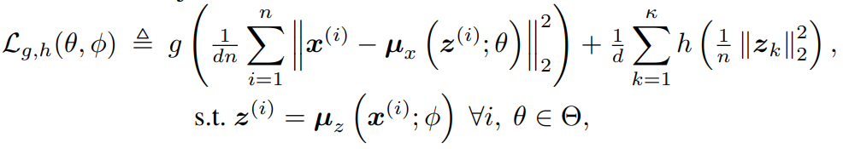
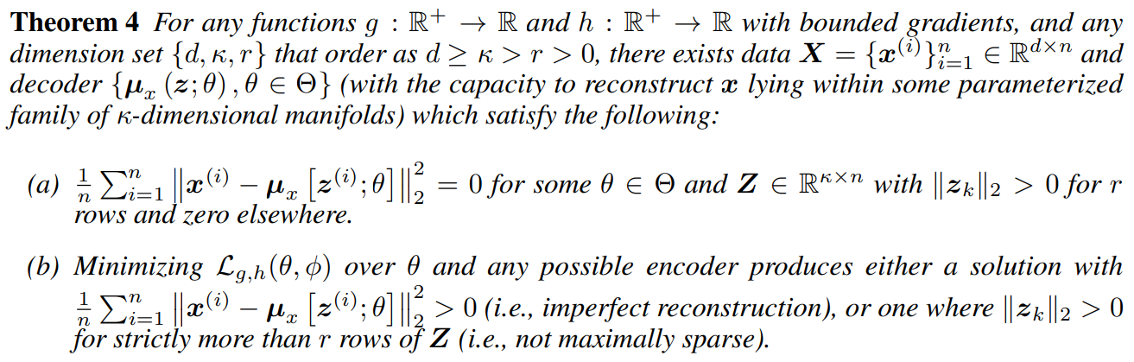

Infinite Gradient Is Integral
For generalized loss of an autoencoder-like model, (i.e. MSE + Regularize-Z)
Minimizing the loss with unbounded $g, h$ (which means a finite gradient)
Cannot produce perfect reconstruction or optimal sparsity

Slide 8

Infinite Gradient Is Integral
An infinite gradient is thus a necessary condition (not a sufficient condition)
Even with other AEs, infinite gradient are essential e.g. AAE, WAE, DAE
The often-ignored decoder variance $γ=σ_{x}(z)$ of VAEs is also essential!
Now let us look at it experimentally
Greens can be infinitely large or small
Reconstruction loss (Distortion)
Regularization loss (Rate)

Slide 9
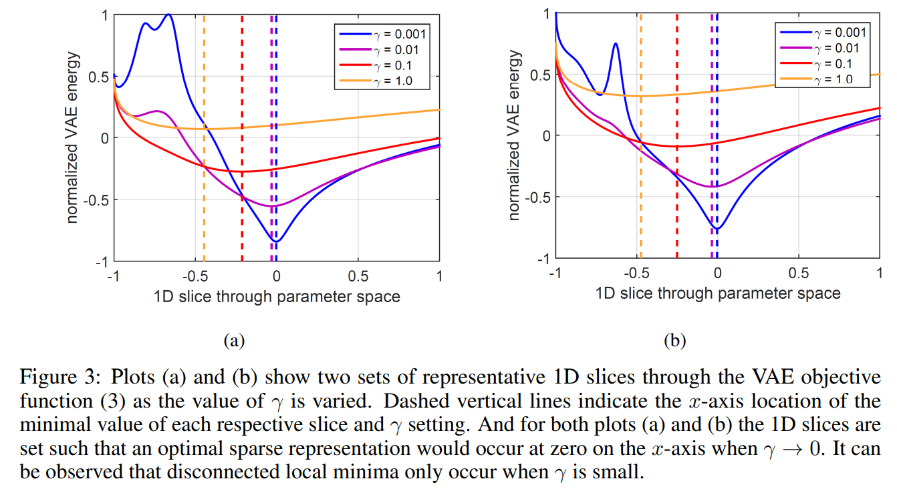
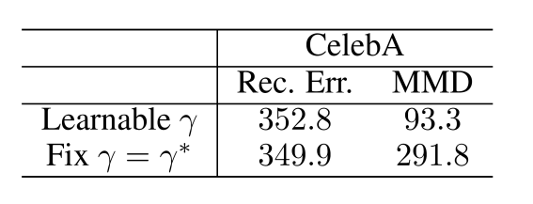

Visualization
A large $γ$ smooths the loss, and a small $γ$ reveals the exact optimal
So if one knows the optimal $γ$ (near 0) and fixes the $γ$ from the start,
One might get the bad result (note the constant $γ$ model $≈$ $β$-VAE)

Slide 10
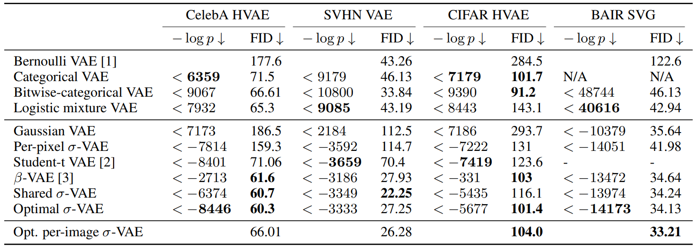
Calibrated Decoder
But the instability of the infinite gradient needs to be addressed!
Rybkin, Oleh, Kostas Daniilidis, and Sergey Levine. "Simple and effective VAE training with calibrated decoders." International Conference on Machine Learning. PMLR, 2021.

Slide 11
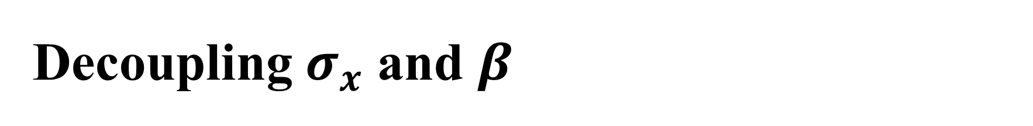
Decoupling $σ_{x}$ and $β$
“For Gaussian VAE models (which is our focus), this scale factor effectively makes no difference if a fixed decoder variance is adopted. In this situation, β can just be directly absorbed into γ, and the d log γ normalization factor from (3) can be viewed as an irrelevant constant.”
Dai, Bin, Li Wenliang, and David Wipf. "On the value of infinite gradients in variational autoencoder models." Advances in Neural Information Processing Systems 34 (2021): 7180-7192.
“The 𝛽-VAE objective is then equivalent to a 𝜎-VAE with a constant variance 𝜎^2=𝛽/2 (for a particular learning rate setting.)”
Rybkin, Oleh, Kostas Daniilidis, and Sergey Levine. "Simple and effective VAE training with calibrated decoders." International Conference on Machine Learning. PMLR, 2021.

Slide 12
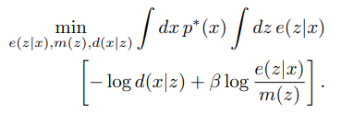
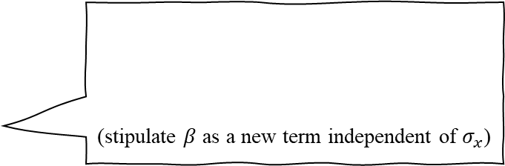
Decoupling $σ_{x}$ and $β$
(stipulate $β$ as a new term independent of $σ_{x}$)
Alemi, Alexander, et al. "Fixing a broken ELBO." International conference on machine learning. PMLR, 2018.
“Importantly, the Gaussian partition function for a Gaussian observation model (the last term on the RHS of Eq. (10)) prevents ELBO from deviating from the β-VAE’s objective with a β-weighted KL term while maintaining the benefits to representation learning when σ2 is small.
Lucas, James, et al. "Don't blame the elbo! a linear vae perspective on posterior collapse." Advances in Neural Information Processing Systems 32 (2019).
Burgess, Christopher P., et al. "Understanding disentangling in $\beta $-VAE." arXiv preprint arXiv:1804.03599 (2018).
(same as the first above)

Slide 13
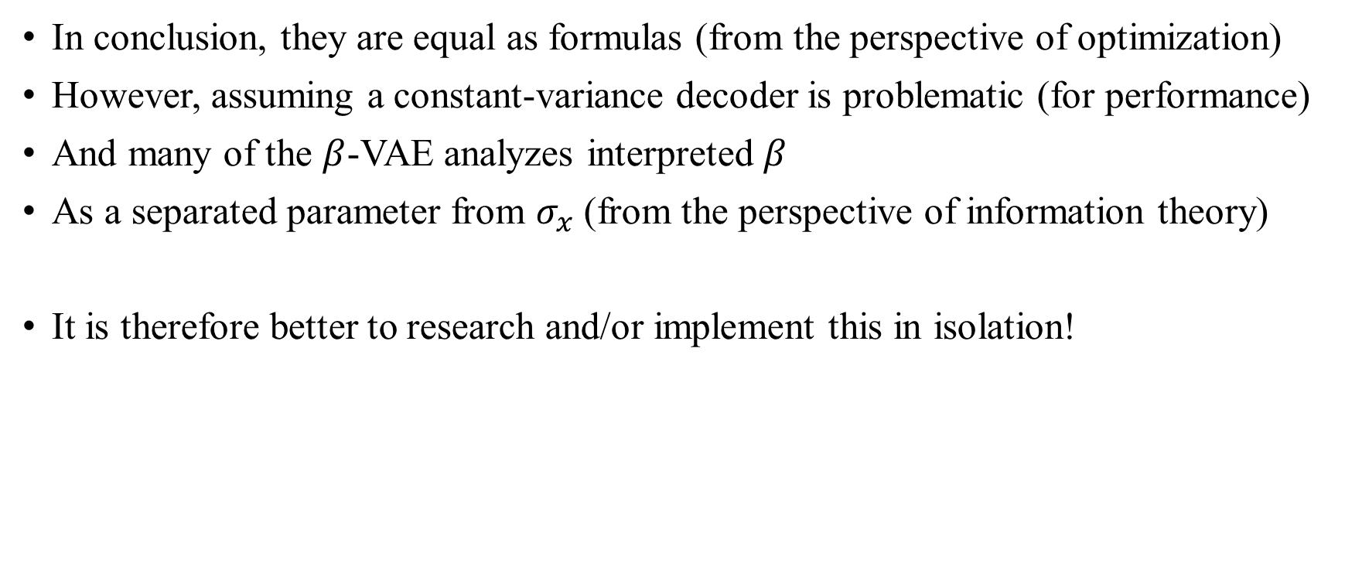
Decoupling $σ_{x}$ and $β$
In conclusion, they are equal as formulas (from the perspective of optimization)
However, assuming a constant-variance decoder is problematic (for performance)
And many of the $β$-VAE analyzes interpreted $β$
As a separated parameter from $σ_{x}$ (from the perspective of information theory)
It is therefore better to research and/or implement this in isolation!

Slide 14
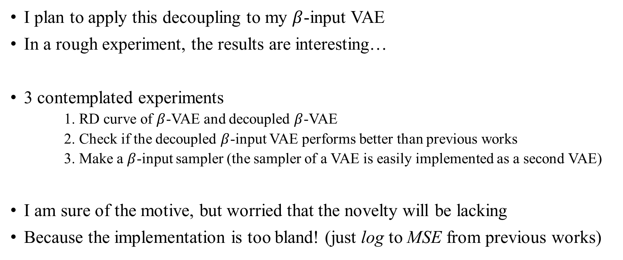
Decoupling $σ_{x}$ and $β$
I plan to apply this decoupling to my $β$-input VAE
In a rough experiment, the results are interesting…
3 contemplated experiments
1. RD curve of $β$-VAE and decoupled $β$-VAE
2. Check if the decoupled $β$-input VAE performs better than previous works
3. Make a $β$-input sampler (the sampler of a VAE is easily implemented as a second VAE)
I am sure of the motive, but worried that the novelty will be lacking
Because the implementation is too bland! (just log to MSE from previous works)

Slide 15
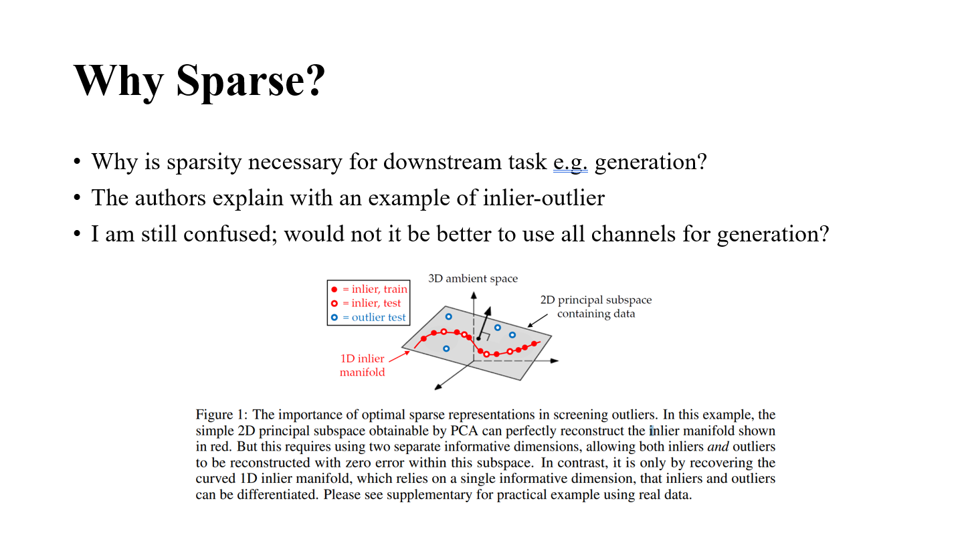
Discussion
Optimal (minimal) sparse representation is necessary for generation?
Conversely, is not a maximal sparse representation (bounded by latent dimension)
Required empirically?
While the authors’ argument makes intuitive sense,
It conflicts with my previous understanding of generation…

Slide 16
Thank you for listening
Presenter: Kim Seung Hwan (overnap@khu.ac.kr)

